Slide 1
Great GRAINS
“Make at least half your grains whole!”

Slide 2
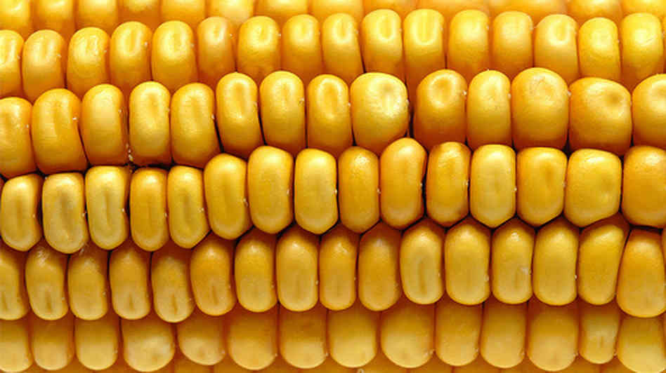
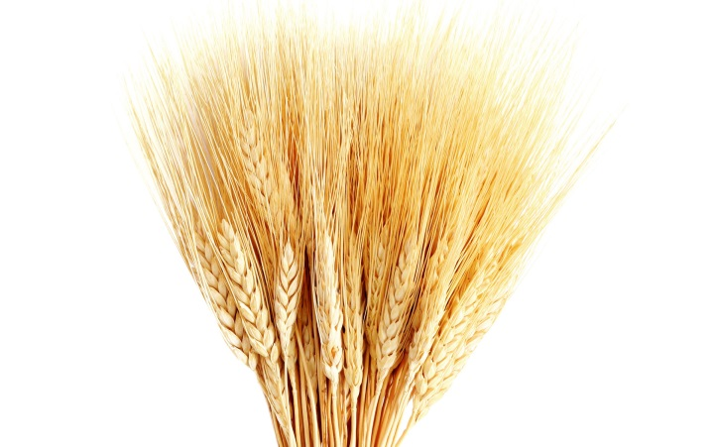
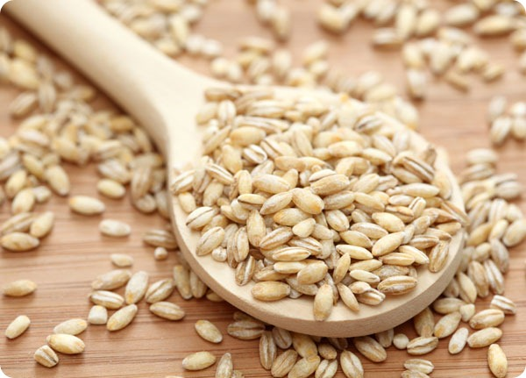
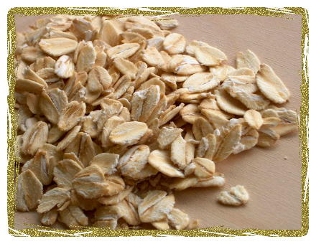
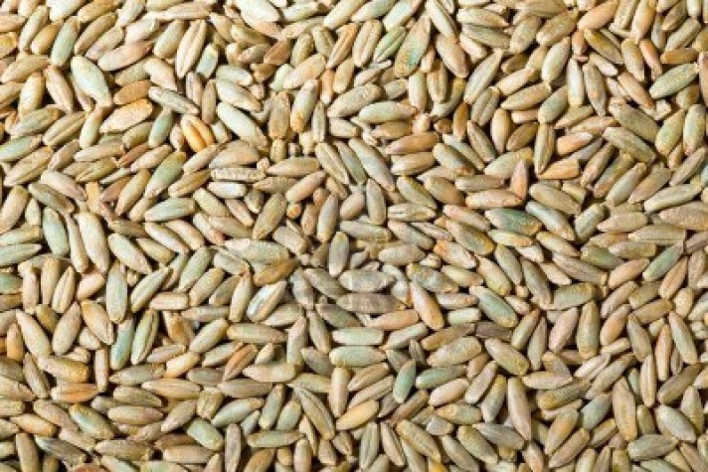
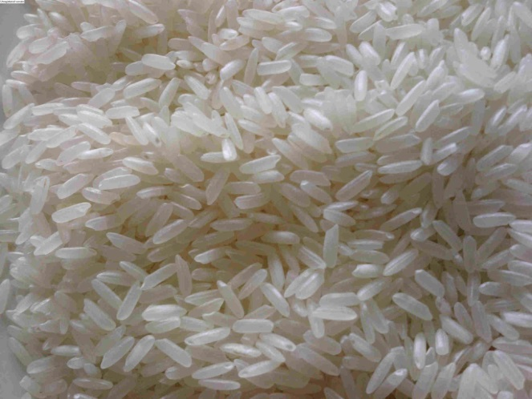
Can you name these grains?

Slide 3
What do you eat that’s made with wheat?
White/wheat sandwich bread
Pancakes
Tortilla chips
Hotdog buns
Crackers
Pasta

Slide 4
What do you eat that’s made with corn?
Corn Flakes
Cornbread
Corn Tortillas
Corn Chex

Slide 5
What do you eat that’s made with barley?
Soups
Side dishes
WHEN YOU’RE 21+… Beer

Slide 6
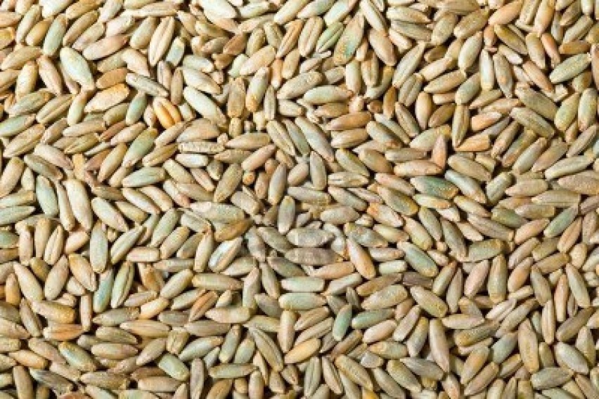
What do you eat that’s made with Rye?
Bread (with Dill dip, yum!)
Reuben Sandwiches

Slide 7
What do you eat that’s made with oats?
Oatmeal
Apple Crisp
Honey Bunches of Oats
Nature Valley Granola Bars

Slide 8
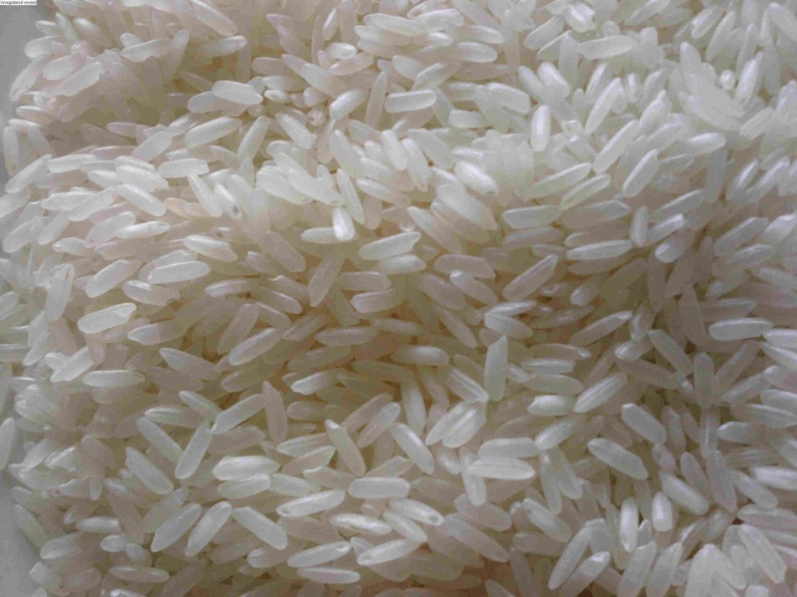
What do you eat that’s made with Rice?
Fried Rice
Rice Krispies
Rice-a-Roni
Rice pudding

Slide 9
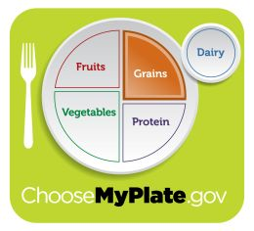
Why Grains?

Slide 10
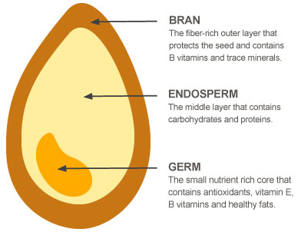
Grain Structure
Grains differ in size and shape, but they all have kernels with similar structures.
Remember! Whole Grain = All 3, Refined Grain = Endosperm

Slide 11
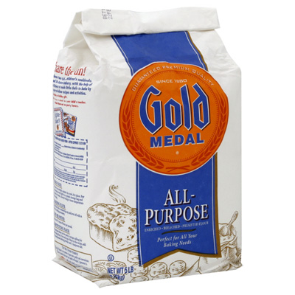
So what is flour?
Flour is the ground version of any of the 6 grains!
But the most commonly used is wheat because it holds up best due to Gluten when baking.
MY (INSERT PERSON HERE) IS ALLERGIC TO GLUTEN!
Gluten is the elastic protein found in wheat

Slide 12
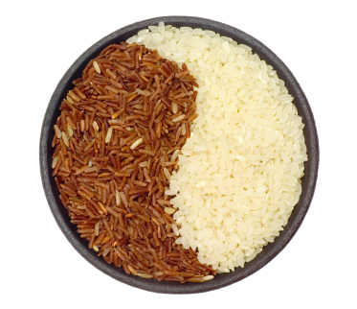
What’s better, White or Brown Rice?
Brown is more nutritional!
White rice is only the endosperm of rice
Brown rice still has the nutritious bran and germ

Slide 13
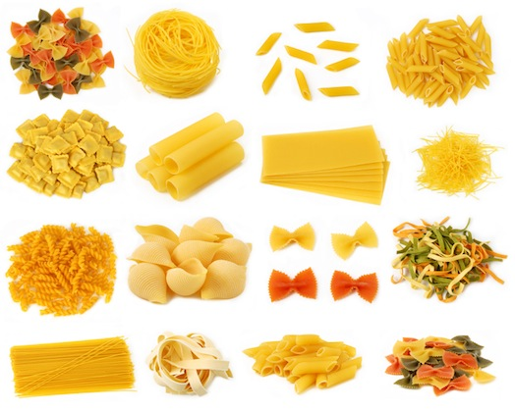
Can pasta be made from all grains?
Probably… Is it? No.
Pasta is made with wheat flour

Slide 14
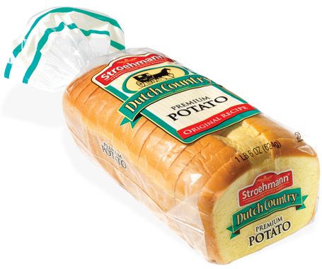
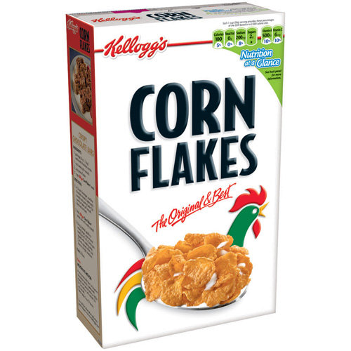
Some vegetables are high in starch, does that make them a grain too?
It can, starch is: a complex carbohydrate that is stored in plants.
Carbohydrates are not only found in grains although they are most often associated with the grain group.

